Slide 1

Array methods
Add/remove items, Iterate

Slide 2
Splice – syntax
It modifies arr starting from the index start: removes deleteCount elements and then inserts elem1, ..., elemN at their place. Returns the array of removed elements.
It modifies arr starting from the index start: removes deleteCount elements and then inserts elem1, ..., elemN at their place. Returns the array of removed elements.
It modifies arr starting from the index start: removes deleteCount elements and then inserts elem1, ..., elemN at their place. Returns the array of removed elements.

Slide 3
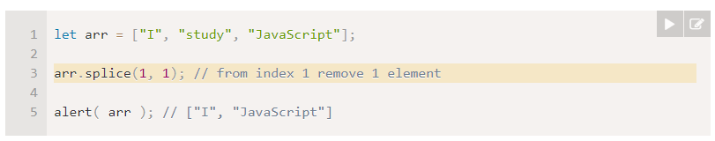
Splice
If we want to delete an element in array, but also we want the rest of elements to shift and occupy the freed place, we use the method splice instead of delete
The arr.splice method can do everything: insert, remove and replace elements.
We can output the removed elements

Slide 4
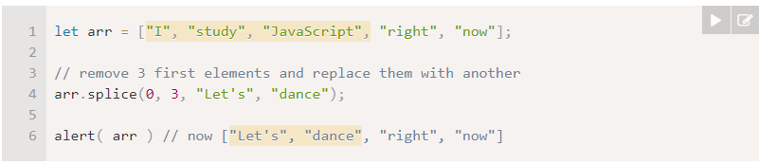
Splice – replace removed elements
Also method splice can remove elements and replace them with other elements

Slide 5
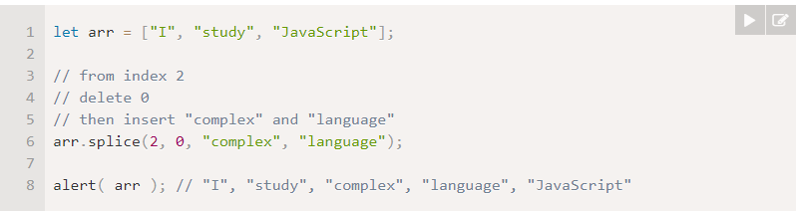
Splice – insert elements
The splice method is also able to insert the elements without any removals
For that we need to set deleteCount to 0

Slide 6
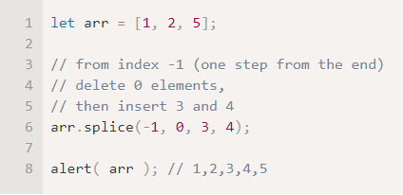
Negative indexes allowed!!!

Slide 7

Slice - syntax
It returns a new array copying to it all items from index start to end (not including end). Both start and end can be negative.

Slide 8
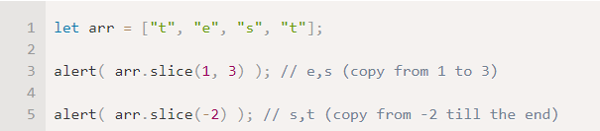
Slice
It’s similar to a string method str.slice, but instead of substrings it makes subarrays.
We can also call it without arguments: arr.slice() creates a copy of arr.

Slide 9

Concat - syntax
The method arr.concat creates a new array that includes values from other arrays and additional items.

Slide 10
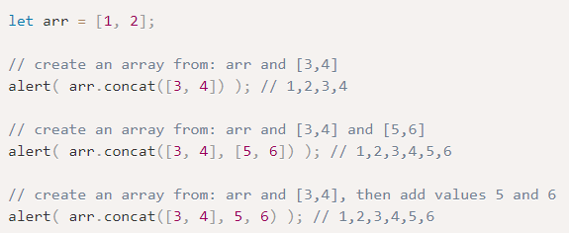
Concat
It accepts any number of arguments – either arrays or values.
The result is a new array containing items from arr, then arg1, arg2 etc.

Slide 11
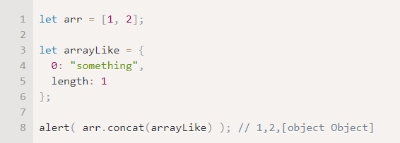
Concat - objects
Normally, it only copies elements from arrays. Other objects, even if they look like arrays, are added as a whole:

Slide 12
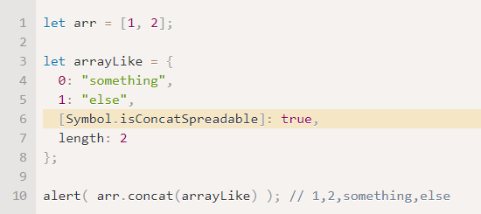
Concat - objects
But if an array-like object has a special Symbol.isConcatSpreadable property, then it’s treated as an array by concat

Slide 13

Iterate: forEach - syntax
The arr.forEach method allows to run a function for every element of the array.

